Slide 1
Abstract Factory
Design Pattern
By Joshua Neutrom (#39), Yunlong Liu (#25), Chen Wang (#58), Dayu Wang (#59)

Slide 2
Introduction
Definition
Relationship
Benefits
Negatives
Illustration
UML
Code Example
Input/Output of Code
Questions

Slide 3
Abstract Factory Design Pattern Definition
Creational Design Pattern
Creates and knows families of related objects (wrapper)
Platform independence
Factory method per product
Class derived for each platform
Centralized creation for decentralized instantiation

Slide 4
Relationship to Other Design Patterns
Similarities
Can be a Singleton
Implemented by Factories or Prototypes
Differences
Alternative to a Facade
Different production style from a Builder

Slide 5
Negatives
Adds complexity
Slower than constructors
Difficult to troubleshoot

Slide 6
Benefits
Encapsulation
Wrapper for various objects
Platform independence

Slide 7
Illustration - Budget Creation
Create a budget with various spending categories (products)
Frugal, Intermediate, and Amusement types of budgets (platforms)

Slide 8
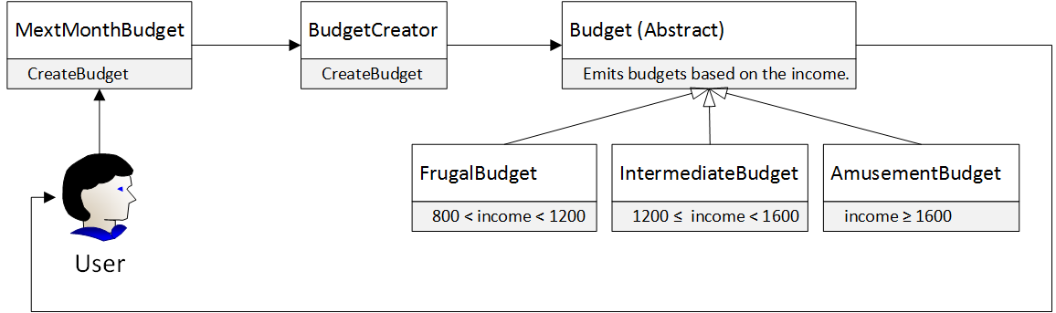
Sample Code
Factory

Slide 9
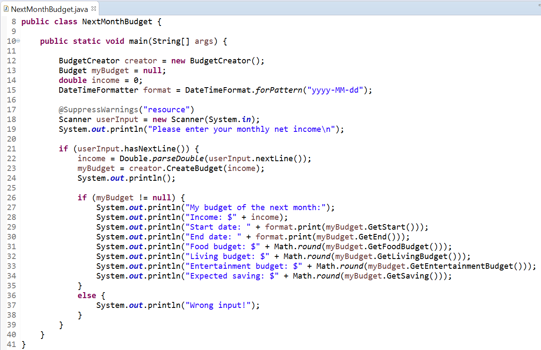
Code

Slide 10
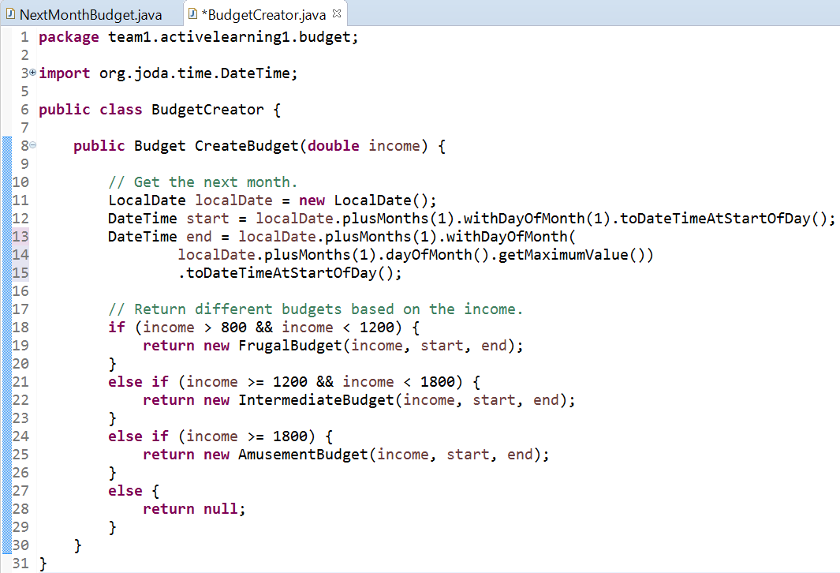
Code

Slide 11
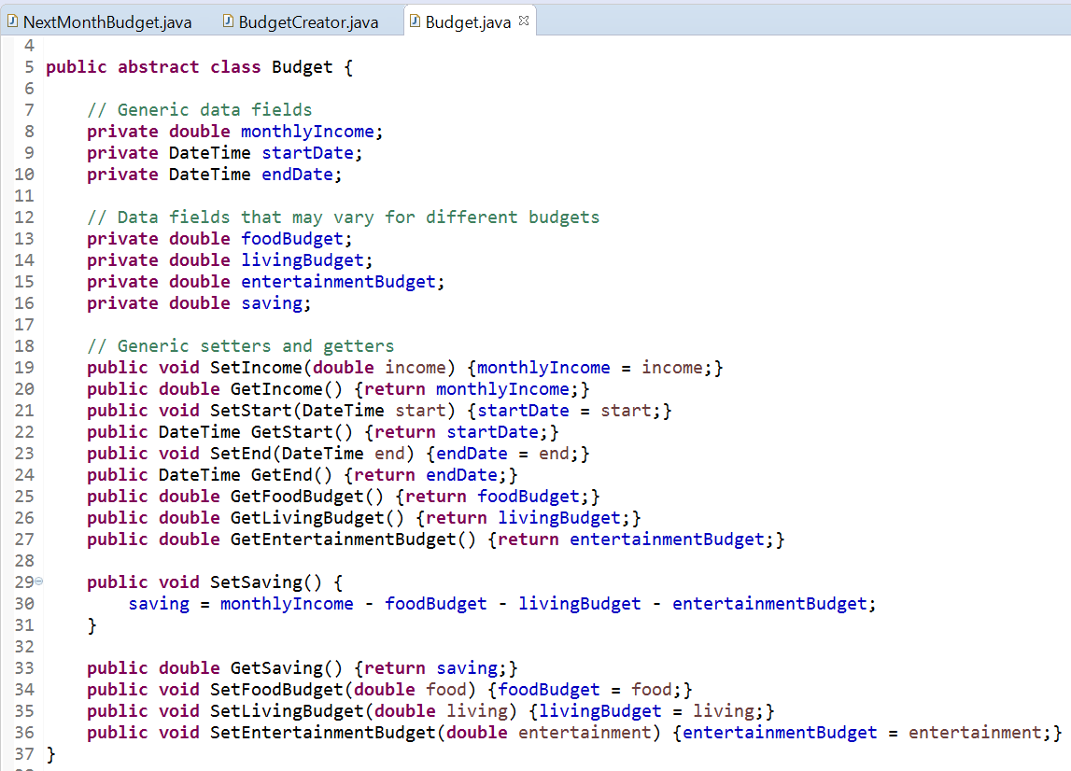
Code

Slide 12
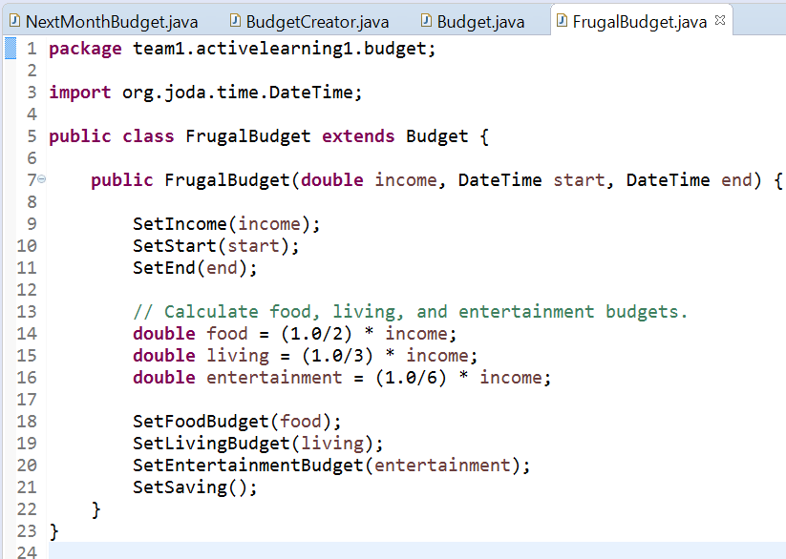
Code

Slide 13
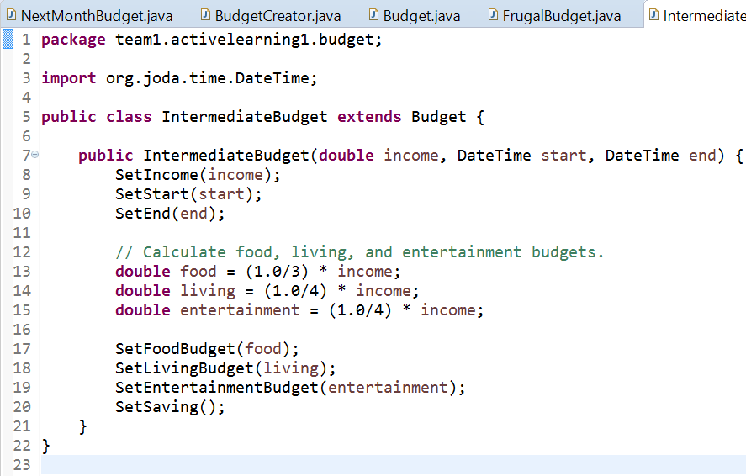
Code

Slide 14
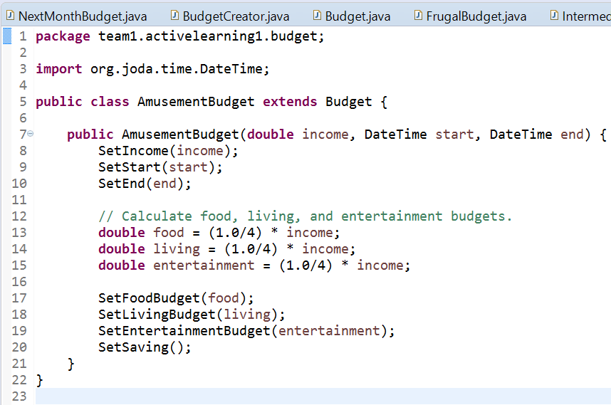
Code

Slide 15
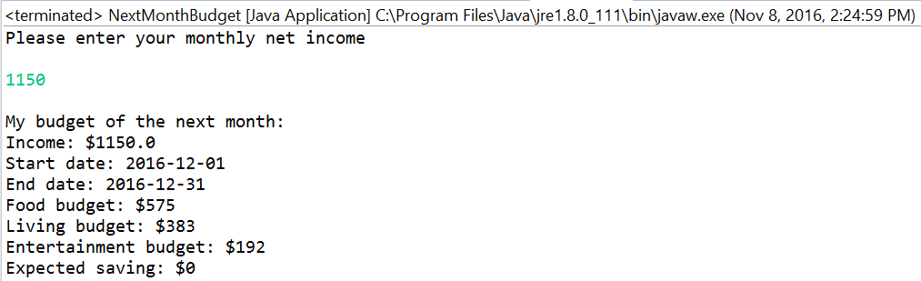
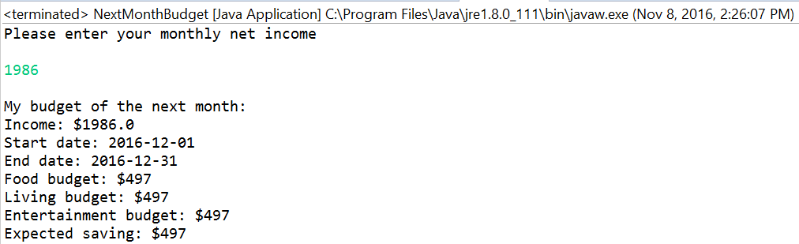
Input/Output

Slide 16
Conclusion
Definition
Benefits
Negatives
Illustration
UML
Code Example
Input/Output of Code
Questions

Slide 17
Questions/Compliments

